Slide 1
Introduction to Git and GitHub
Ready To Learn?

Slide 2
What will we be learning today?
What is a Version Control
Basic CLI Commands
Introduction to Git
Introduction to GitHub

Slide 3


Let's Visualize
You are a designer
poster.png
final-poster.png
final-final-poster.png
pls-stop.png

Slide 4
What is Version Control System?
Version Control System manages the entire process of version and keeps the track of the changes made.
We need VCS to:
track the changes made
revert back to any versions when needed
compare the changes made between any two versions
to know information like who, when, why made the changes
to get all these benefits with minimal effort

Slide 5
Basic CLI Commands
Prints the full name (the full path) of current/working directory
Changes the working directory to Desktop Use this to navigate around CLI
$ cd/pwd
$ cd Desktop
$ dir/ls
List directory contents
$ mkdir name
Create a new directory called name.
$ del/rm file.txt
Removes the file file.txt
Let's Try it!

Slide 6
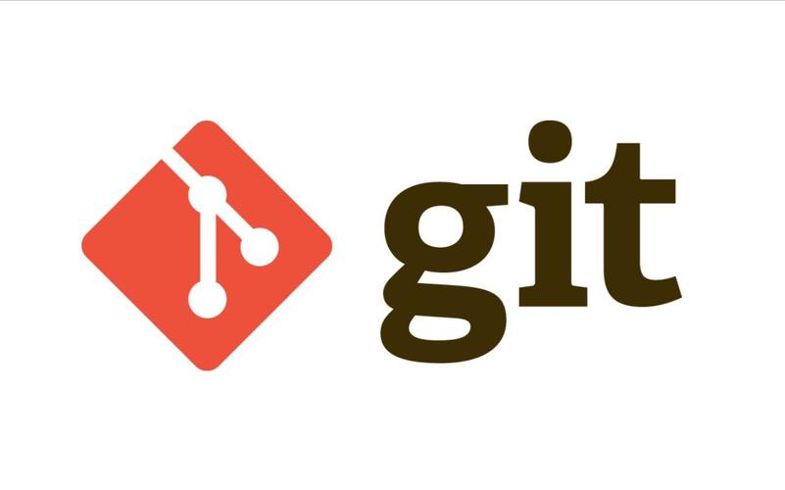
What is Git?
Git is a free and open source distributed version control system designed to handle everything from small to very large projects with speed and efficiency.
Let's Install Git
https://git-scm.com/downloads

Slide 7
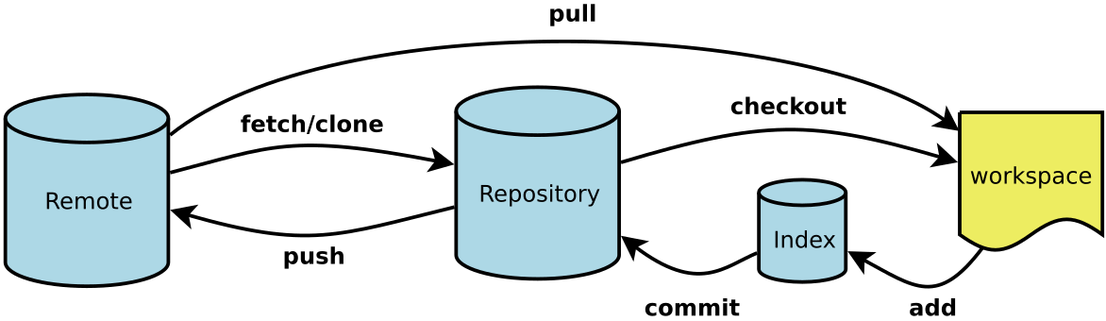
How Git works
Remote : a version of your project that is hosted on the internet or another network.
Repository : a folder that contains all your project's files and the entire change history.
Index : is where you prepare changes before committing them.
Workplace : is your local working directory.

Slide 8
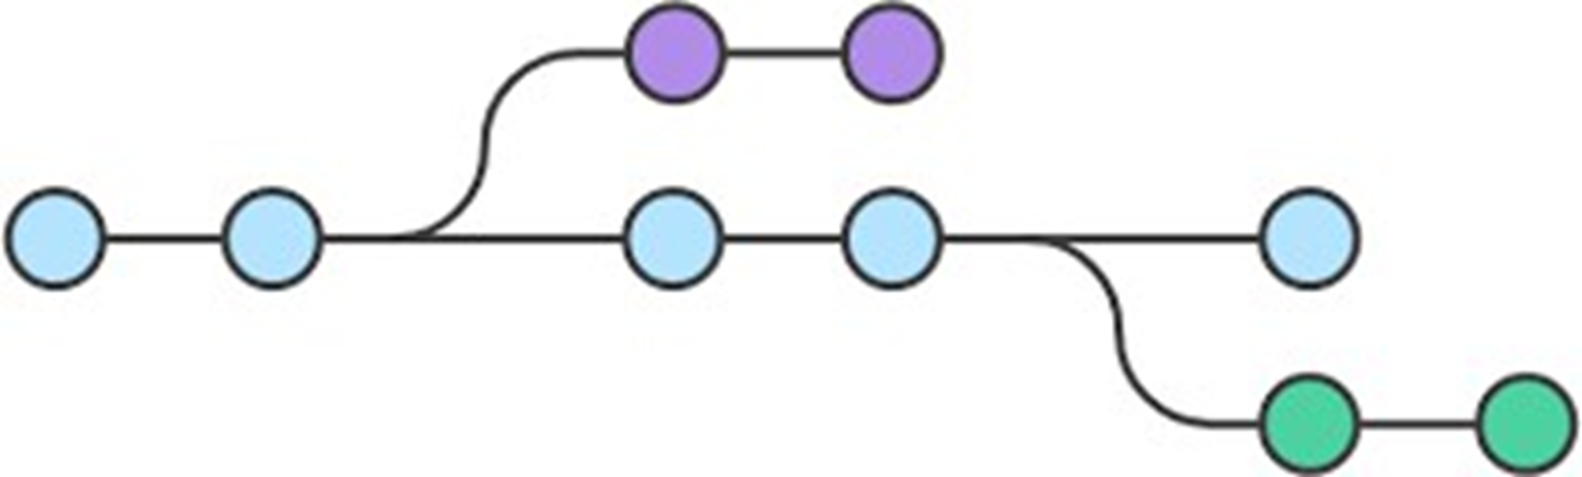
Setup Git
Git Commands
Branch
A branch in Git is like a separate line of development in your project. It allows you to work on new features or fixes without affecting the main code.

Slide 9

What is GitHub?
Till now, we have all the changes made saved in our local system only
To host our repository online, we need a server or hosting platform
GitHub is a repository hosting platform that uses Git in its core
Let's make an account!

